Slide 1

UNIX BSD
Hiroki Morimoto

Slide 2
BSD Scheduler
Uses Multilevel Feedback queue
  Runnable processes are assigned a scheduling priority that determines in which run queue they are placed.
  Dispatcher chooses first process on highest priority queue.
  Process is allowed to run in user mode for up to one quantum before it is preempted; default quantum: 100ms.
  Processes that use a lot of CPU have their priorities lowered.
  Processes blocked for a long time for I/O have their priorities raised, so that they will run soon after I/O is finished.

Slide 3
BSD scheduler (cont)
Round Robin scheduling per queue
Preemptive time-slicing (time quantum)
Dynamically adjust priority
  Complete your time slice: priority drops
  Give up the CPU before the end: priority stays same
  Inactive processes have priority increased

Slide 4
BSD scheduler (cont)
Priority based scheduling
Process have two scheduling priorities
  p_pripority—priority when inside the kernel
  p_usrpti—priority when executing user code
Scheduling priority range, hi to lo: 0 – 127
  higher priority preempts the lower priority
  0-49 kernel mode
  50-127 user mode
Has 32 ready queues
Time quantum set to 0.1 second for over 15 years
Has sleep priorities

Slide 5
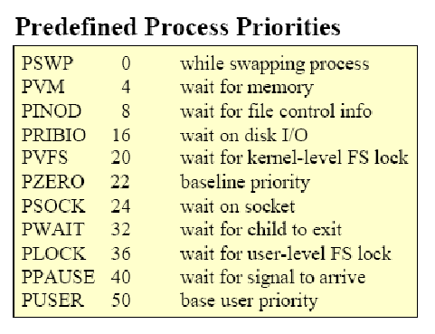
Scheduling Related Attribute

Slide 6
Priority Calculation
Proc Structure
  p_estcpu: provides estimate of recent CPU utilization
  p_nice: user-settable weighting factor between -20 and 20 (default 0)
p_usrpri recalculated every 4 clock ticks
  priority = PUSER - (recent_cpu / 4) - (nice * 2),
p_estcpu incremented each clock tick process is running
p_estcpu aged every second

Slide 7
Process Synchronization
BSD is primitive kernel
BSD uses semaphores in shared memory for synchronization
Semaphores must lie within a MAP_SHARED region with at least modes PROT_READ and PROT_WRITE.

Slide 8
Process Synchronization (cont)
To acquire a lock a process calls:
  value = mset(sem, wait)
  result int value; semaphore *sem; int wait
Mset indivisibly tests and sets the semaphore sem.
If the previous value is zero, the process has acquired the lock and mset returns true immediately. Otherwise, if the wait flag is zero, failure is returned.
If wait is true and the previous value is non-zero, mset relinquishes the processor until notified that it should retry.

Slide 9
Process Synchronization (cont)
To release a lock a process calls:
  mclear(sem)
  semaphore *sem;
Mclear indivisibly tests and clears the semaphore sem.
If the ‘‘WANT’’ flag is zero in the previous value, mclear returns immediately.
If the ‘‘WANT’’ flag is non-zero in the previous value, mclear arranges for waiting processes to retry before returning.

Slide 10
Process Synchronization (cont)
Two routines provide services analogous to the kernel sleep and wakeup functions interpreted in the domain of shared memory.
A process may relinquish the processor by calling msleep with a set semaphore:
  msleep(sem)
  semaphore *sem;
If the semaphore is still set when it is checked by the kernel, the process will be put in a sleeping state until some other process issues an mwakeup for the same semaphore within the region using the call:
  mwakeup(sem)
  semaphore *sem;
An mwakeup may awaken all sleepers on the semaphore, or may awaken only the next sleeper on a queue.

Slide 11
Sources
http://en.wikipedia.org/wiki/BSD
http://www.freebsd.org/doc/ja_JP.eucJP/books/design-44bsd/index.html
http://netweb.usc.edu/ftp/pub/cs558/Slides/
http://docs.freebsd.org/44doc/psd/05.sysman/paper.pdf
http://www.arl.wustl.edu/~fredk/Courses/cs422/sp01/Lectures/
http://www.hpdc.syr.edu/~chapin/cis657/ProcMan.ppt#6

